Slide 1

Network :structural chracteristics
Clustering Coefficients
Closeness Centrality
Betweenness Centrality
Eigenvector Centrality
Complete, Regular and bipartite graph: Example
Average path length of lattice in different dimension
Notes:
The Human Disease Network, whose nodes are diseases connected if they have common genetic origin.
K.-I. Goh, M. E. Cusick, D. Valle, B. Childs, M. Vidal, and A.-L. Barabasi.
The human disease network. PNAS, 104:8685–8690, 2007.

Slide 2
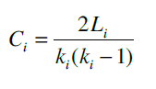
Clustering Coefficients
The clustering coefficient captures the degree to which the neighbors of a given node link to each other. For a node with degree the local clustering coefficient is defined as
Notes:
The Human Disease Network, whose nodes are diseases connected if they have common genetic origin.
K.-I. Goh, M. E. Cusick, D. Valle, B. Childs, M. Vidal, and A.-L. Barabasi.
The human disease network. PNAS, 104:8685–8690, 2007.

Slide 3
Clustering Coefficients
The clustering coefficient captures the degree to which the neighbors of a given node link to each other. For a node with degree the local clustering coefficient is defined as
CC of the center node (purple)
Notes:
The Human Disease Network, whose nodes are diseases connected if they have common genetic origin.
K.-I. Goh, M. E. Cusick, D. Valle, B. Childs, M. Vidal, and A.-L. Barabasi.
The human disease network. PNAS, 104:8685–8690, 2007.

Slide 4
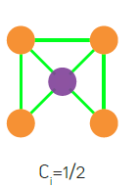
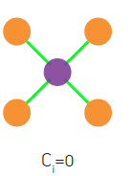
Clustering Coefficients
The clustering coefficient captures the degree to which the neighbors of a given node link to each other. For a node with degree the local clustering coefficient is defined as
CC of the center node (purple)
Notes:
The Human Disease Network, whose nodes are diseases connected if they have common genetic origin.
K.-I. Goh, M. E. Cusick, D. Valle, B. Childs, M. Vidal, and A.-L. Barabasi.
The human disease network. PNAS, 104:8685–8690, 2007.

Slide 5
Clustering Coefficients
Notes:
The Human Disease Network, whose nodes are diseases connected if they have common genetic origin.
K.-I. Goh, M. E. Cusick, D. Valle, B. Childs, M. Vidal, and A.-L. Barabasi.
The human disease network. PNAS, 104:8685–8690, 2007.

Slide 6
Clustering Coefficients
n=length(G);
C=zeros(n,1);
for u=1:n
V=find(G(u,:));
k=length(V);
if k>=2 %degree must be at least 2
S=G(V,V);
C(u)=sum(S(:))/(k^2-k);
end
end
https://github.com/mdhumphries/SmallWorldNess
Notes:
The Human Disease Network, whose nodes are diseases connected if they have common genetic origin.
K.-I. Goh, M. E. Cusick, D. Valle, B. Childs, M. Vidal, and A.-L. Barabasi.
The human disease network. PNAS, 104:8685–8690, 2007.

Slide 7
Clustering Coefficients
Notes:
The Human Disease Network, whose nodes are diseases connected if they have common genetic origin.
K.-I. Goh, M. E. Cusick, D. Valle, B. Childs, M. Vidal, and A.-L. Barabasi.
The human disease network. PNAS, 104:8685–8690, 2007.

Slide 8
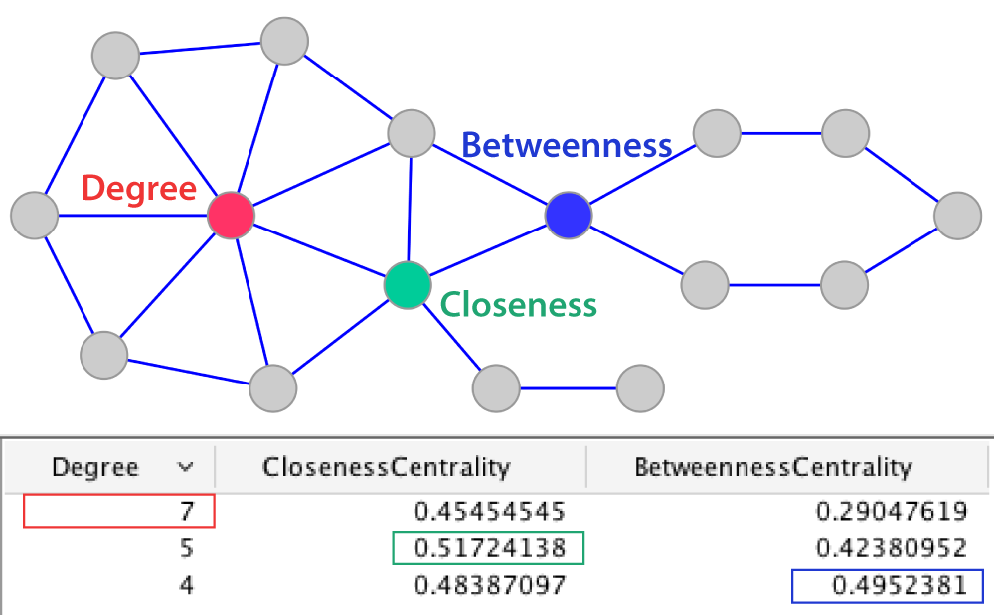
Centralities
$C_{i}=1/{\sum_{j=1}^{n}{d\left(i,j\right)}}$
Ralucca Gera, NPS

Slide 9
Centralities
$C_{i}=1/{\sum_{j=1}^{n}{d\left(i,j\right)}}$
Ralucca Gera, NPS

Slide 10
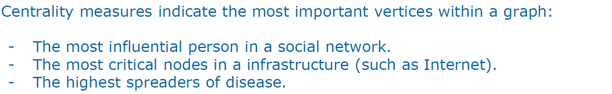
Network Analysis: Centrality measures

Slide 11
Network Analysis: Centrality measures

Slide 12
Different types of centralities
What makes a vertex central in a network? (one or more ideas) | How do you describe it mathematically? | When is it appropriate to use it? | How can we capture it?

Slide 13
Different types of centralities
What makes a vertex central in a network? (one or more ideas) | How do you describe it mathematically? | When is it appropriate to use it? | How can we capture it?
Lots of one-hop connections from | The number of vertices that influences directly | Local influence matters Small diameter | Degree centrality (or simply the )

Slide 14
Different types of centralities
What makes a vertex central in a network? (one or more ideas) | How do you describe it mathematically? | When is it appropriate to use it? | How can we capture it?
Lots of one-hop connections from | The number of vertices that influences directly | Local influence matters Small diameter | Degree centrality (or simply the )
Lots of one-hop connections from relative to the size of the graph | The proportion of the vertices that influences directly | Local influence matters Small diameter | Normalized degree centrality

Slide 15
Different types of centralities
What makes a vertex central in a network? (one or more ideas) | How do you describe it mathematically? | When is it appropriate to use it? | How can we capture it?
Lots of one-hop connections from | The number of vertices that influences directly | Local influence matters Small diameter | Degree centrality (or simply the )
Lots of one-hop connections from relative to the size of the graph | The proportion of the vertices that influences directly | Local influence matters Small diameter | Normalized degree centrality
In the “middle” of the graph - closeness centrality | Close to everyone at the same time | The efficiency of a vertex of reaching everyone quickly (spreading news or a virus for example)
$C_{u}=1/{\sum_{v=1}^{n}{d\left(u,v\right)}}$

Slide 16
Different types of centralities
What makes a vertex central in a network? (one or more ideas) | How do you describe it mathematically? | When is it appropriate to use it? | How can we capture it?
Lots of one-hop connections from | The number of vertices that influences directly | Local influence matters Small diameter | Degree centrality (or simply the )
In the “middle” of the graph - closeness centrality | Close to everyone at the same time | The efficiency of a vertex of reaching everyone quickly (spreading news or a virus for example)
Lots of one-hop connections to high centrality vertices | A weighted degree centrality based on the weight of the neighbors (instead of a weight of 1 as in degree centrality) | For example when the people you are connected to matter. | Eigenvector centrality (recursive formula):
$C_{u}=1/{\sum_{v=1}^{n}{d\left(u,v\right)}}$
Ralucca Gera, NPS

Slide 17
Closeness Centrality
Reciprocal of the total distance from a node v to all the other nodes in a network
d(u,v) is the distance between node u and v.
$C_{u}=1/{\sum_{v=1}^{n}{d\left(u,v\right)}}$
$C_{i}=1/{\sum_{j=1}^{n}{d\left(i,j\right)}}$
Closeness centrality can be viewed as the efficiency of a vertex in spreading information to all other vertices.
Ralucca Gera, NPS

Slide 18
Eigenvector Centrality
A natural extension of degree centrality is eigenvector centrality.
$C_{i}=1/{\sum_{j=1}^{n}{d\left(i,j\right)}}$
Ralucca Gera, NPS

Slide 19
Eigenvector Centrality
A natural extension of degree centrality is eigenvector centrality.
In-degree centrality awards one centrality point for every link a node receives. But not all vertices are equivalent: some are more relevant than others, and, reasonably, endorsements from important nodes count more.
$C_{i}=1/{\sum_{j=1}^{n}{d\left(i,j\right)}}$
Ralucca Gera, NPS

Slide 20
Eigenvector Centrality
A natural extension of degree centrality is eigenvector centrality.
In-degree centrality awards one centrality point for every link a node receives. But not all vertices are equivalent: some are more relevant than others, and, reasonably, endorsements from important nodes count more.
EVC : A node is important if it is linked to by other important nodes.
$C_{i}=1/{\sum_{j=1}^{n}{d\left(i,j\right)}}$
Ralucca Gera, NPS

Slide 21
Eigenvector Centrality
$C_{i}=1/{\sum_{j=1}^{n}{d\left(i,j\right)}}$
Ralucca Gera, NPS

Slide 22
Eigenvector Centrality
$C_{i}=1/{\sum_{j=1}^{n}{d\left(i,j\right)}}$
Ralucca Gera, NPS

Slide 23
Eigenvector Centrality
$C_{i}=1/{\sum_{j=1}^{n}{d\left(i,j\right)}}$
Ralucca Gera, NPS

Slide 24
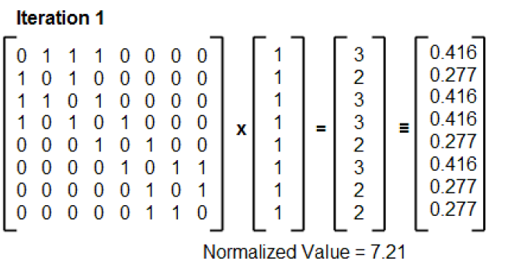
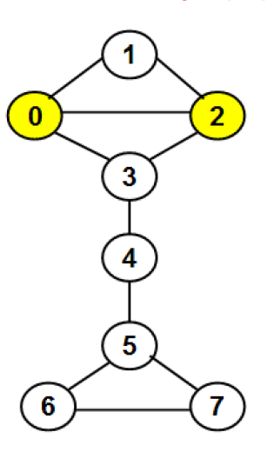
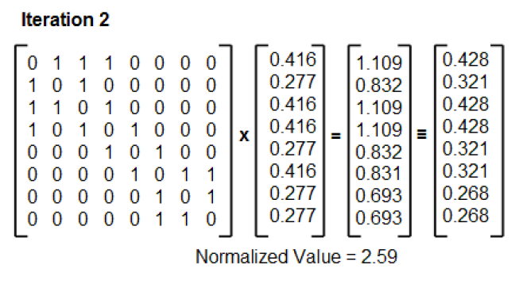
Eigenvector Centrality
$C_{i}=1/{\sum_{j=1}^{n}{d\left(i,j\right)}}$
Dr. Natarajan Meghanathan
Ralucca Gera, NPS

Slide 25
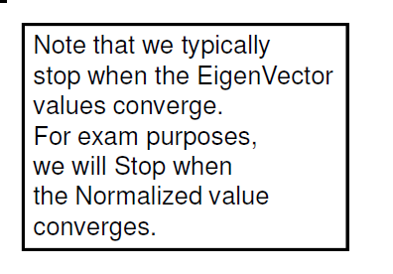
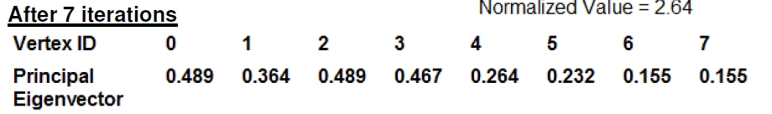
Eigenvector Centrality
$C_{i}=1/{\sum_{j=1}^{n}{d\left(i,j\right)}}$
Ralucca Gera, NPS

Slide 26
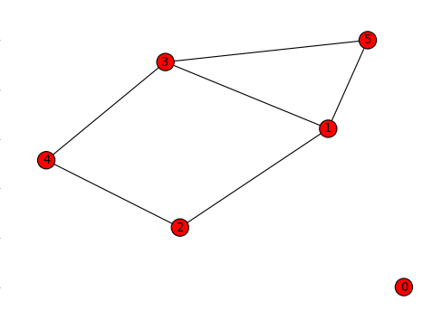
Eigenvector Centrality
clear all
A=zeros(6,6);
A(5,[1 3])=1;
A(2,[1 4])=1;
A([1 4],3)=1;
A=A+A';
[u lam]=eig(A);
evc_large=u(:,6);
$C_{i}=1/{\sum_{j=1}^{n}{d\left(i,j\right)}}$
Ralucca Gera, NPS

Slide 27
Eigenvector Centrality
Example 1 (Eigenvector centrality)
Node : Eigenvect. centrality
0: 0,
1: 0.5298987782873977,
2: 0.3577513877490464,
3: 0.5298987782873977,
4: 0.3577513877490464,
5: 0.4271328349194304

Slide 28
Eigenvector Centrality
Example 1 (Eigenvector centrality)
Node : Eigenvect. centrality
0: 0,
1: 0.5298987782873977,
2: 0.3577513877490464,
3: 0.5298987782873977,
4: 0.3577513877490464,
5: 0.4271328349194304

Slide 29
Eigenvector Centrality
Example 1 (Eigenvector centrality)
Node : Eigenvect. centrality
0: 0,
1: 0.5298987782873977,
2: 0.3577513877490464,
3: 0.5298987782873977,
4: 0.3577513877490464,
5: 0.4271328349194304
Notice that deg(5) < deg (4). Why

Slide 30
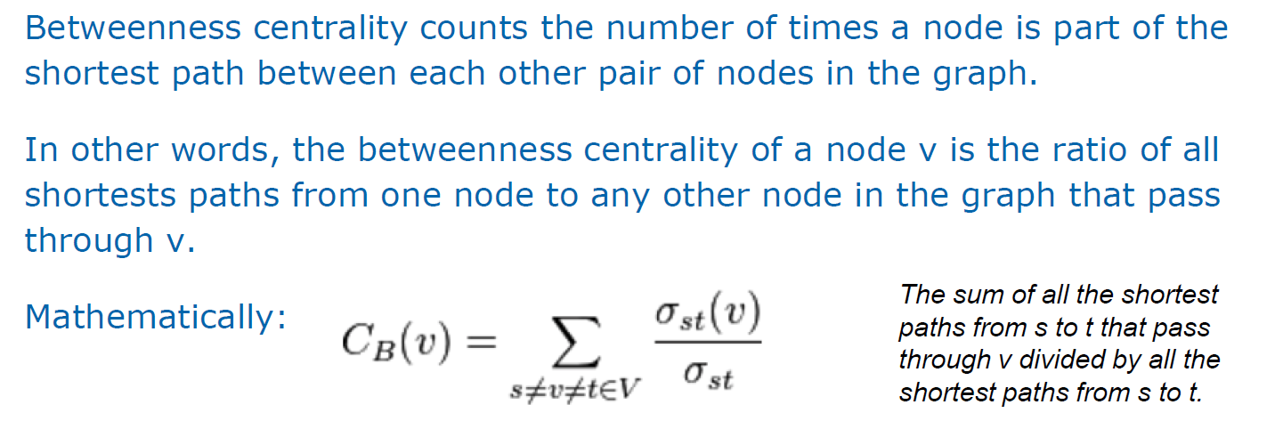
Node Betweenness
$C_{i}=1/{\sum_{j=1}^{n}{d\left(i,j\right)}}$
Shortest path based betweenness centrality
Ralucca Gera, NPS

Slide 31
Centralities
$C_{i}=1/{\sum_{j=1}^{n}{d\left(i,j\right)}}$
Ralucca Gera, NPS

Slide 32
Centralities
betweenness closeness
1 7 0.381944444444445 0.454545454545455
2 3 0 0.405405405405405
3 3 0 0.384615384615385
4 3 0 0.333333333333333
5 3 0 0.333333333333333
6 3 0 0.333333333333333
7 4 0.244444444444444 0.483870967741936
8 5 0.475000000000000 0.517241379310345
9 4 0.604166666666667 0.483870967741936
10 2 0.225000000000000 0.365853658536585
11 2 0.0930555555555556 0.294117647058824
12 2 0.0208333333333333 0.245901639344262
13 2 0.0166666666666667 0.294117647058824
14 2 0.148611111111111 0.365853658536585
15 2 0.208333333333333 0.365853658536585
16 1 0 0.272727272727273
$C_{i}=1/{\sum_{j=1}^{n}{d\left(i,j\right)}}$
Ralucca Gera, NPS

Slide 33
Complete and bipartite graph
The complete graph on n vertices is denoted K_{n}, and is the graph on n vertices where every pair of distinct vertices are adjacent.
A bipartite graph is one where the vertices are divided into two classes, R and B say, with the property that every edge has one end in R and the other end in B. Star and lattices.

Slide 34
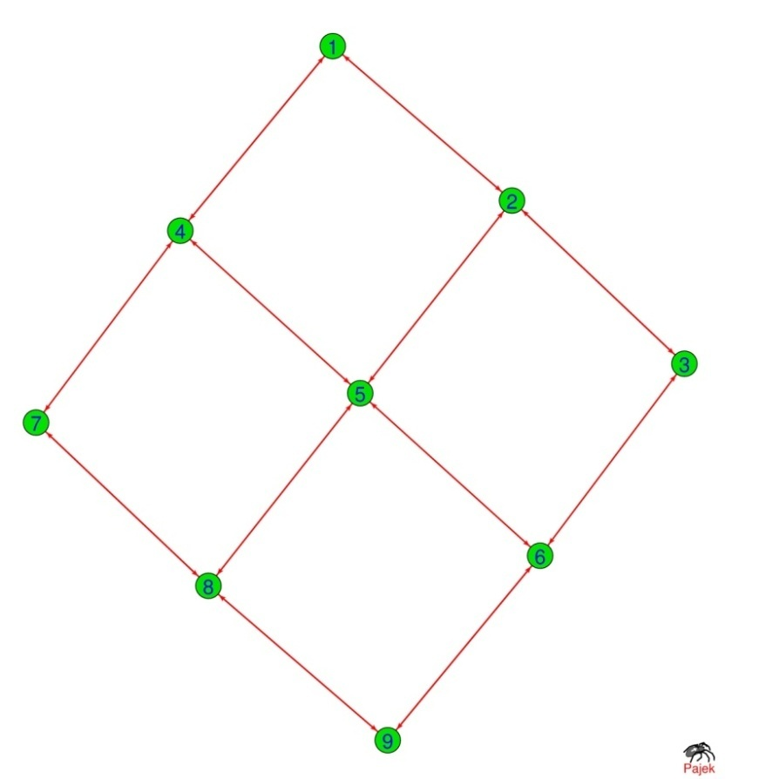
Bipartite graph
1
3
5
7
9
4
2
6
8

Slide 35
Bipartite Graphs: Subprojections
A bipartite graph (or bigraph) is a network whose nodes can be divided into two disjoint sets U and V such that each link connects a U-node to a V-node. In other words, if we color the U-nodes green and the V-nodes purple, then each link must connect nodes of different colors.
Notes:
The Human Disease Network, whose nodes are diseases connected if they have common genetic origin.
K.-I. Goh, M. E. Cusick, D. Valle, B. Childs, M. Vidal, and A.-L. Barabasi.
The human disease network. PNAS, 104:8685–8690, 2007.

Slide 36
Examples of complex networks: geometric, regular
Human Disease Network
Notes:
The Human Disease Network, whose nodes are diseases connected if they have common genetic origin.
K.-I. Goh, M. E. Cusick, D. Valle, B. Childs, M. Vidal, and A.-L. Barabasi.
The human disease network. PNAS, 104:8685–8690, 2007.

Slide 37
Examples of complex networks: geometric, regular
Human Disease Network: Two Projections
Notes:
The Human Disease Network, whose nodes are diseases connected if they have common genetic origin.
K.-I. Goh, M. E. Cusick, D. Valle, B. Childs, M. Vidal, and A.-L. Barabasi.
The human disease network. PNAS, 104:8685–8690, 2007.

Slide 38
Actor Networks
In network theory we encounter numerous bipartite networks. A well-known example is the Hollywood actor network, in which one set of nodes corresponds to movies (U), and the other to actors (V). A movie is connected to an actor if the actor plays in that movie
Notes:
The Human Disease Network, whose nodes are diseases connected if they have common genetic origin.
K.-I. Goh, M. E. Cusick, D. Valle, B. Childs, M. Vidal, and A.-L. Barabasi.
The human disease network. PNAS, 104:8685–8690, 2007.

Slide 39
Flavor Networks
Notes:
The Human Disease Network, whose nodes are diseases connected if they have common genetic origin.
K.-I. Goh, M. E. Cusick, D. Valle, B. Childs, M. Vidal, and A.-L. Barabasi.
The human disease network. PNAS, 104:8685–8690, 2007.

Slide 41
Regular Graphs, Complete Graphs
Regular Graph
Connected
All nodes have same degree
Notes:
The Human Disease Network, whose nodes are diseases connected if they have common genetic origin.
K.-I. Goh, M. E. Cusick, D. Valle, B. Childs, M. Vidal, and A.-L. Barabasi.
The human disease network. PNAS, 104:8685–8690, 2007.

Slide 42
Regular Graph (Open Chain)
A
B
C
D
A
B
A
C
A
D
B
C
B
D
Length 3
C
D
Length 2
4-3=1
Length 1
4-2=2
4-1=3

Slide 43
Regular Graph (Open Chain)
A
B
C
D
E
A
B
A
C
A
D
A
E
Length 4
B
C
B
D
B
E
5-4=1
Length 3
C
D
C
E
5-3=2
Length 2
D
E
5-2=3
Length 1
$\frac{2}{\left(n\left(n−1\right)\right)}\sum_{j=1}^{n−1}{j\left(n−j\right)}=$
5-1=4
+
$\left(n−\frac{\left(2n−1\right)}{3}\right)=\frac{n+1}{3}$

Slide 44
Star Graph
Q: Find the average pathlength, clustering coefficients of start graph.
Change network size , derive mathematically and explain.

Slide 45
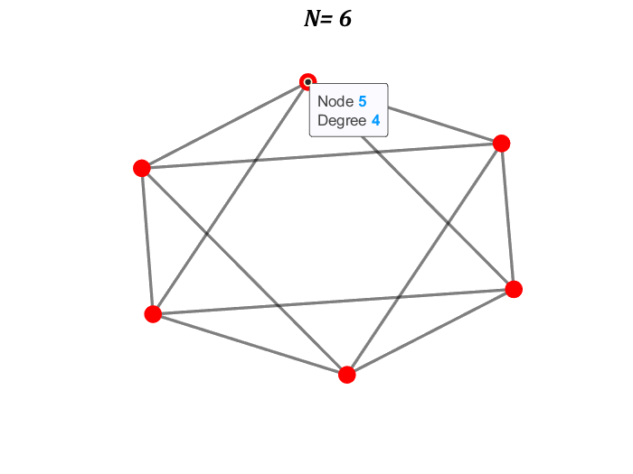
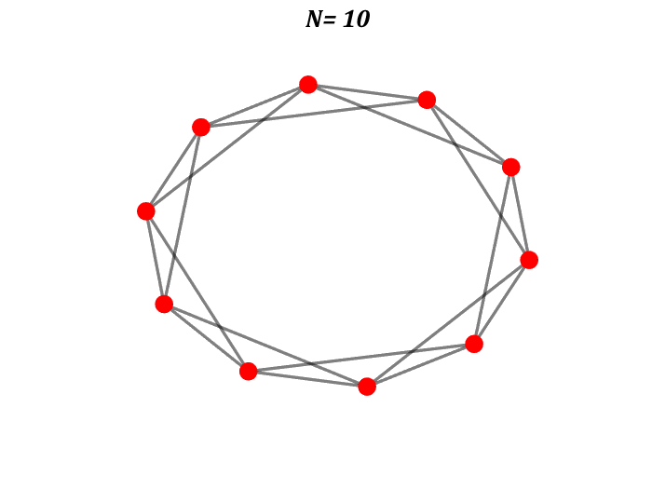
Regular Graph (Ring)
Q: What will be the average pathlength?

Slide 46
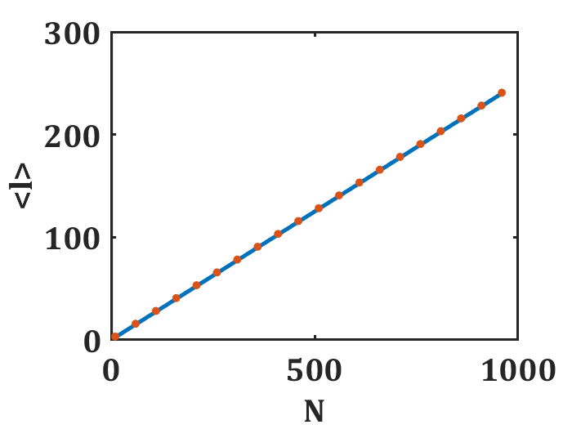
Regular Graph (Ring)
Q: What will be the average pathlength?

Slide 47
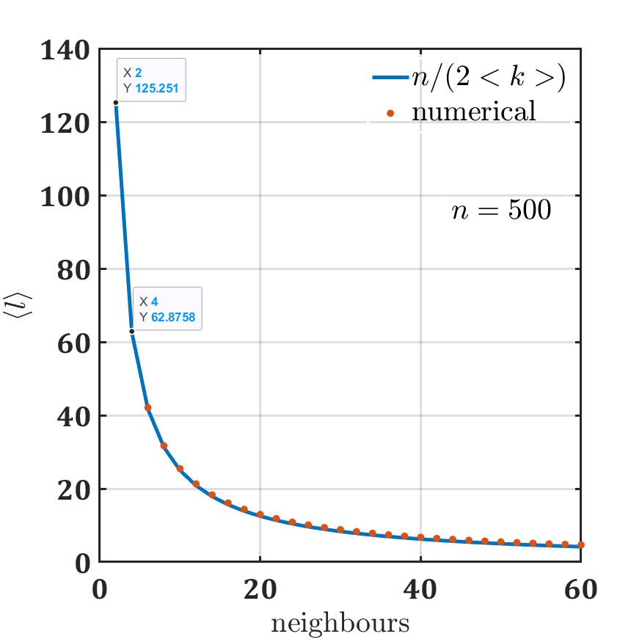
Regular Graph (Ring)
Q: What will be the average pathlength?

Slide 48
Regular Graph (Ring)
n=100;
ZZ=[];
for n=[6 10]
n
c=2;
%for c=1:3:20
A = smallw(n,c,0);
A=zeros(n,n)+A;
%A=A+A;
deg=sum(A);
avg_deg=mean(deg);
l=pathlength(A);
G=graph(A);
figure; plot(G);
deg = degree(G);
end

Slide 49
ONE DIMENSIONAL LATTICE: nodes on a ring
Thus,
$\left\langle l\right\rangle =\frac{4\sum_{l=1}^{l_{max}}{l}}{N}=\frac{4\left(1+2+…+\frac{N}{4}\right)}{N}≈\frac{N}{2∗4}$
The average path-length varies as
Constant degree, constant clustering coefficient.
$\left\langle l\right\rangle ≈N;N≫1$
Network Science: Graph Theory 2012

Slide 50
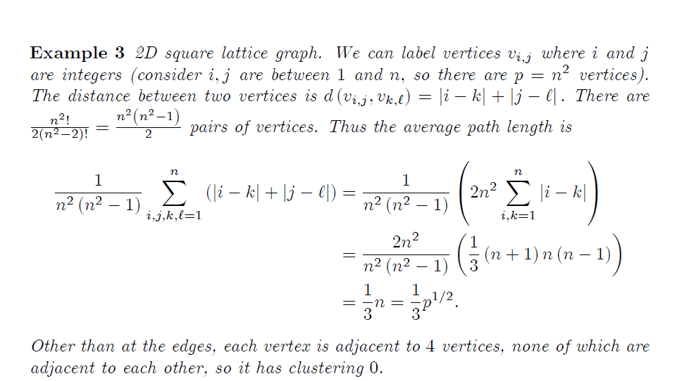
TWO DIMENSIONAL LATTICE
David Glickenstein

Slide 51
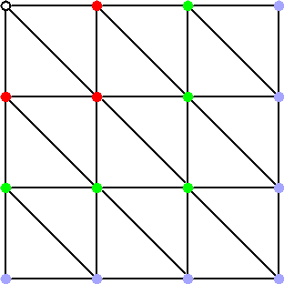
TWO DIMENSIONAL LATTICE
In general, the average distance varies as
where D is the dimensionality of the lattice. Constant degree (coordination number), constant clustering coefficient.
Network Science: Graph Theory 2012

Slide 52
Complete Graphs
Complete Graph
Connected
Each node is connected to all other nodes
Notes:
The Human Disease Network, whose nodes are diseases connected if they have common genetic origin.
K.-I. Goh, M. E. Cusick, D. Valle, B. Childs, M. Vidal, and A.-L. Barabasi.
The human disease network. PNAS, 104:8685–8690, 2007.

Slide 53
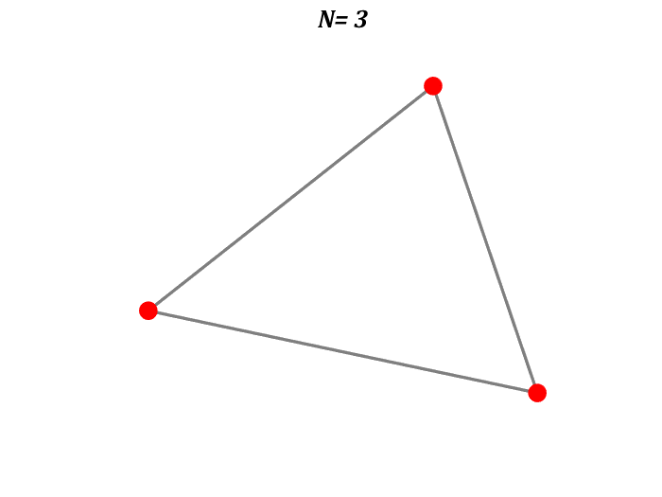
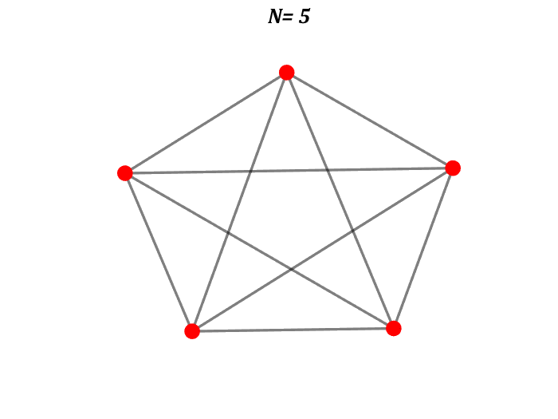
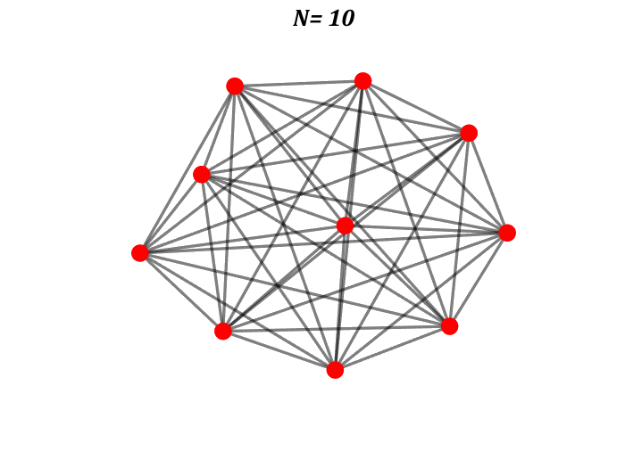
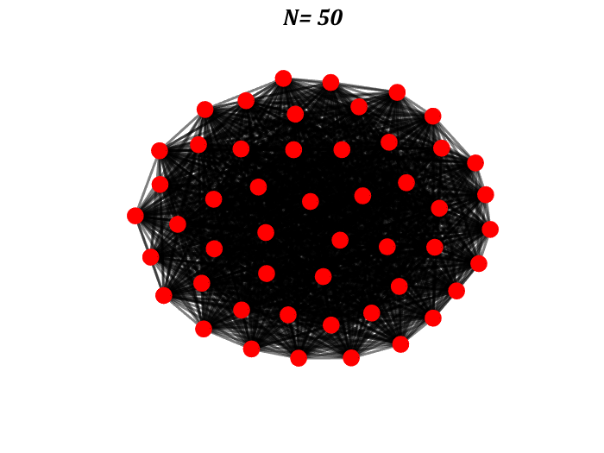
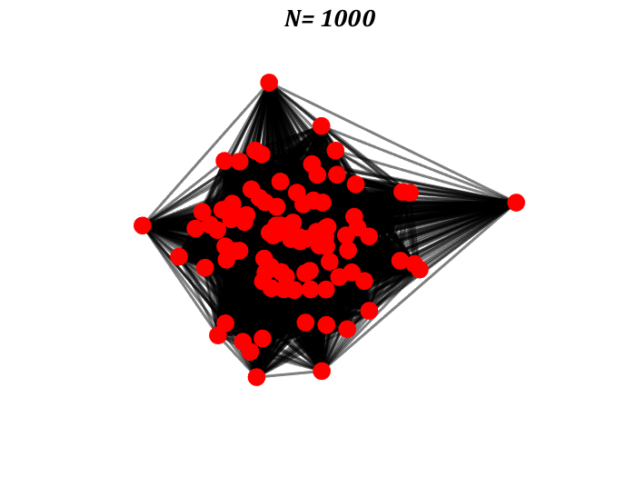
Complete Graphs
Complete Graph
Notes:
The Human Disease Network, whose nodes are diseases connected if they have common genetic origin.
K.-I. Goh, M. E. Cusick, D. Valle, B. Childs, M. Vidal, and A.-L. Barabasi.
The human disease network. PNAS, 104:8685–8690, 2007.

Slide 54
Complete Graphs plot
Complete Graph
for N= [3 5 10 50 1000]
A=ones(N,N);
A(1:N+1:N*N)=0;
G=graph(A);
figure; plot(G);
deg = degree(G);
%deg = degree(h2);
nSizes = 8+4*sqrt(deg-min(deg)+0.5);
% NC=cell2mat(data(j,7));
nColors = rand(N,1)*0+3;%NC(:,3);% deg;
%%
%p=plot(G,'MarkerSize',nSizes,'NodeCData',...
% nColors,'EdgeAlpha',0.5);
p=plot(G,'MarkerSize',nSizes,'EdgeAlpha',0.5);
p.NodeFontSize=0.3;
p.NodeFontWeight='b';
p.EdgeColor='k';
Notes:
The Human Disease Network, whose nodes are diseases connected if they have common genetic origin.
K.-I. Goh, M. E. Cusick, D. Valle, B. Childs, M. Vidal, and A.-L. Barabasi.
The human disease network. PNAS, 104:8685–8690, 2007.

Slide 55
Complete Graphs plot
Complete Graph
for N= [3 5 10 50 1000]
A=ones(N,N);
A(1:N+1:N*N)=0;
G=graph(A);
figure; plot(G);
deg = degree(G);
%deg = degree(h2);
nSizes = 8+4*sqrt(deg-min(deg)+0.5);
% NC=cell2mat(data(j,7));
nColors = rand(N,1)*0+3;%NC(:,3);% deg;
%%
%p=plot(G,'MarkerSize',nSizes,'NodeCData',...
% nColors,'EdgeAlpha',0.5);
p=plot(G,'MarkerSize',nSizes,'EdgeAlpha',0.5);
p.NodeFontSize=0.3;
p.NodeFontWeight='b';
p.EdgeColor='k';
p.LineWidth=2;
p.NodeColor='r';
A=[];
set(findall(gcf,'-property','FontSize'),'FontName','Cambria',...
'FontSize',24,'linewidth',2.0,'fontweight','b')
set(gcf,'InvertHardCopy','off','Color','white');
pp=mat2str(N);
[t]= title(sprintf('N= %s', pp));
% title(['Time= ',num2str(pp), 'Sec'])
% pp=[];
t.FontSize = 16;
t.FontAngle = 'italic';
axis off
end
Notes:
The Human Disease Network, whose nodes are diseases connected if they have common genetic origin.
K.-I. Goh, M. E. Cusick, D. Valle, B. Childs, M. Vidal, and A.-L. Barabasi.
The human disease network. PNAS, 104:8685–8690, 2007.

Slide 56
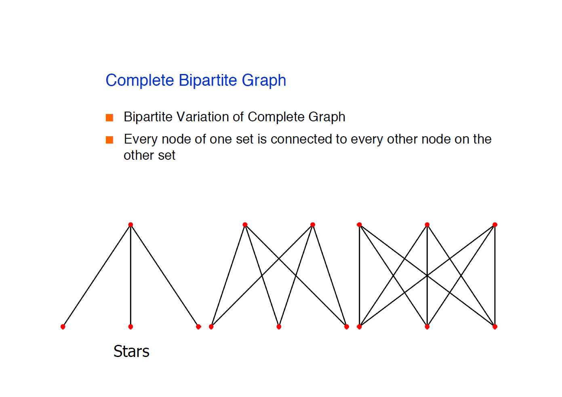
Complete bipartite Graphs
Complete bipartite Graph
Notes:
The Human Disease Network, whose nodes are diseases connected if they have common genetic origin.
K.-I. Goh, M. E. Cusick, D. Valle, B. Childs, M. Vidal, and A.-L. Barabasi.
The human disease network. PNAS, 104:8685–8690, 2007.

Slide 57
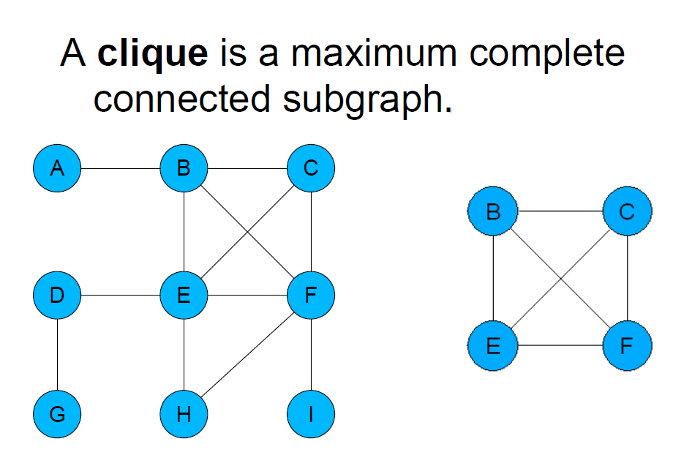
Cliques
Notes:
The Human Disease Network, whose nodes are diseases connected if they have common genetic origin.
K.-I. Goh, M. E. Cusick, D. Valle, B. Childs, M. Vidal, and A.-L. Barabasi.
The human disease network. PNAS, 104:8685–8690, 2007.

Slide 58
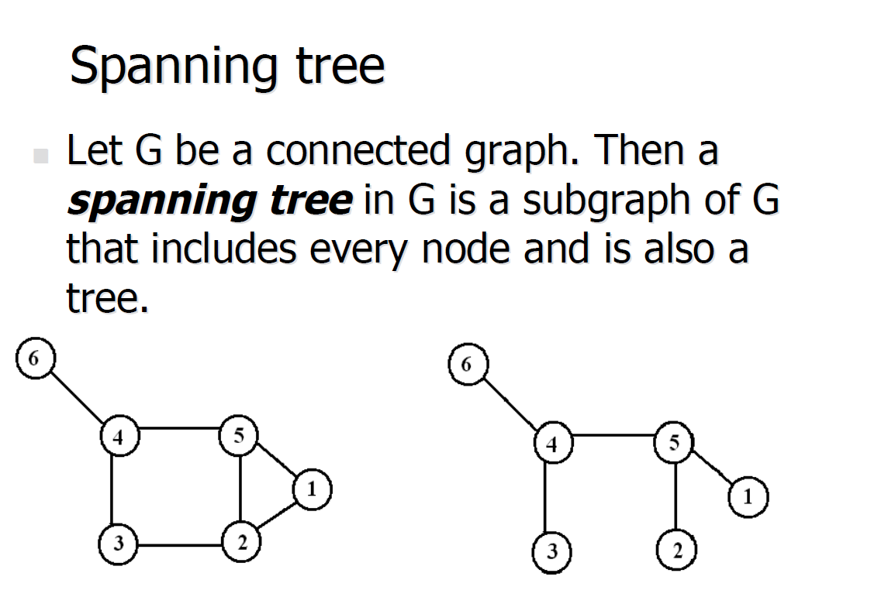
Spanning Tree
Notes:
The Human Disease Network, whose nodes are diseases connected if they have common genetic origin.
K.-I. Goh, M. E. Cusick, D. Valle, B. Childs, M. Vidal, and A.-L. Barabasi.
The human disease network. PNAS, 104:8685–8690, 2007.

